Slide 1

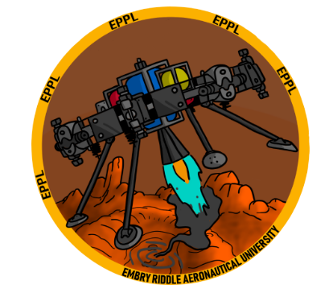
INTEGRATED SPACECRAFT AUTONOMOUS ATTITUDE CONTROL TESTBED (ISAAC)
Authors: Jacob Romeo, Dylan Ballback, Kyle Fox, and Dr. Sergey Drakunov
Keywords: Spacecraft Controls, Education, Hardware-in-the-loop, Pneumatic, 3D-Printing, Testbed, Open-Sourced, IMU, Sliding-Mode Controller

Slide 2

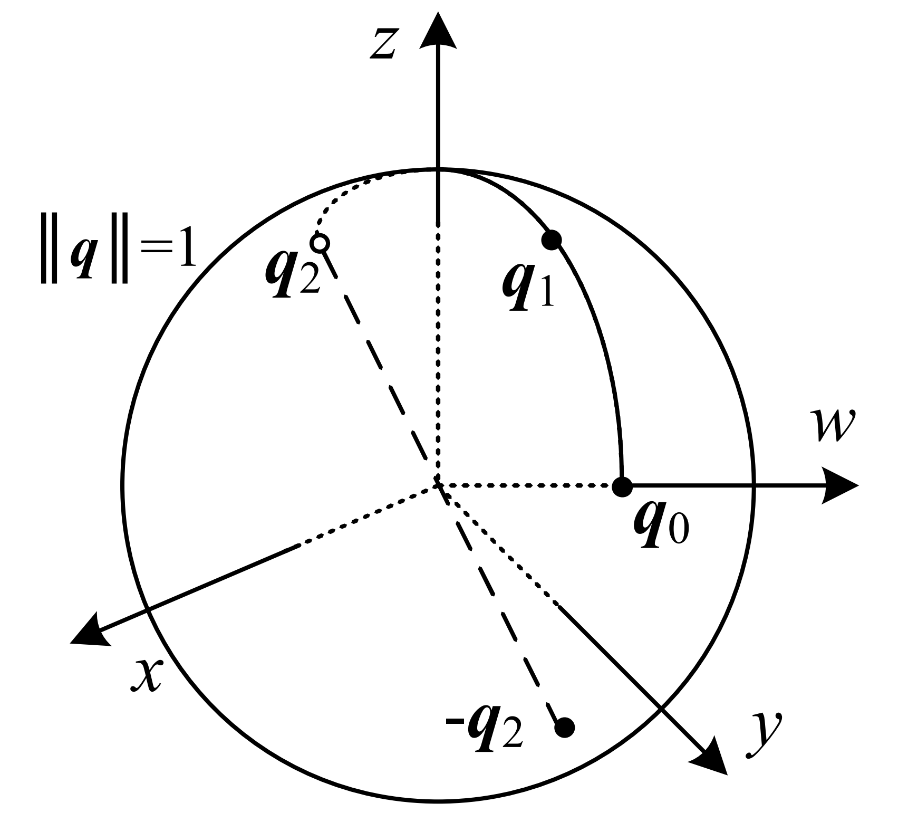
INTRODUCTION
Spacecraft Attitude Controls mathematics are commonly very abstract.
Hard to visualize concepts.
Creating educational tool for students/researchers for spacecraft attitude dynamics and controls.
3D printed with cost effective consumer electronics.
Website makes the hardware accessible to users.
Notes:
General introduction slide

Slide 3
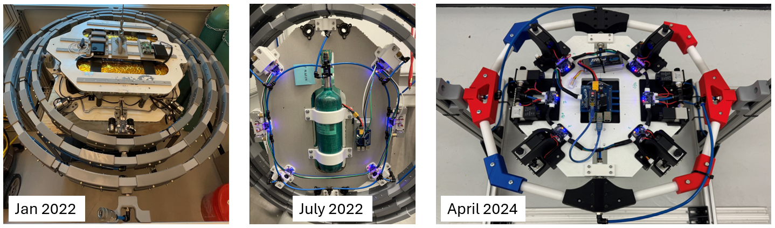
BACKGROUND
NASA Swampworks
FreeFlyer
V2 Spacecraft
V3 Spacecraft/Gimbal Rings
Notes:
General introduction slide

Slide 4
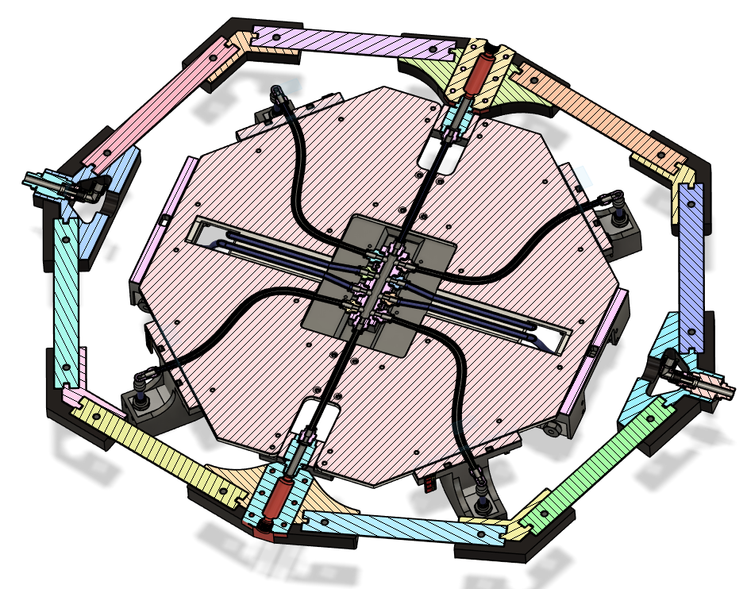
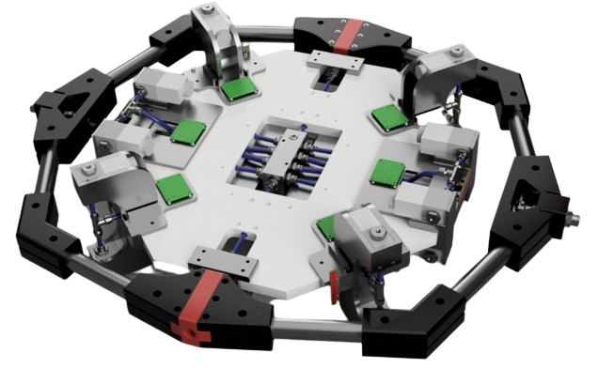
DESIGN AND ASSEMBLY
Rotary
Union
Rotary
Union
ISAAC w/ single gimbal ring cross-section
ISAAC w/ single gimbal ring configuration
Notes:
Full text slide

Slide 5
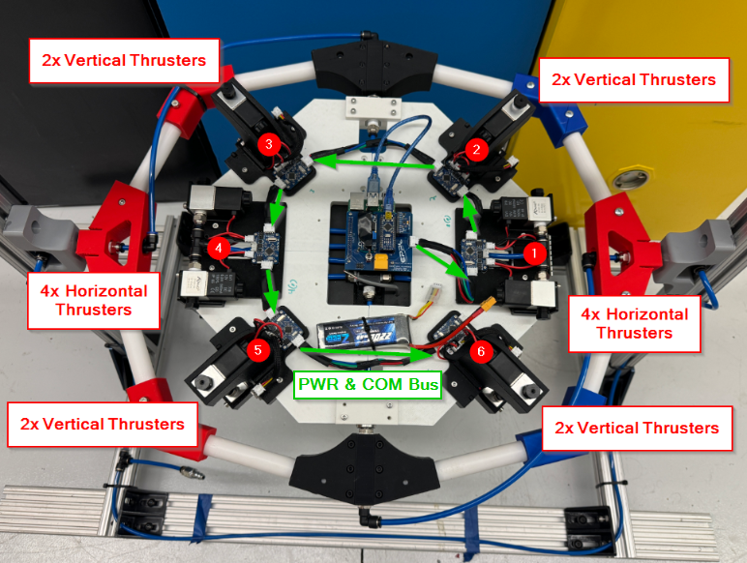
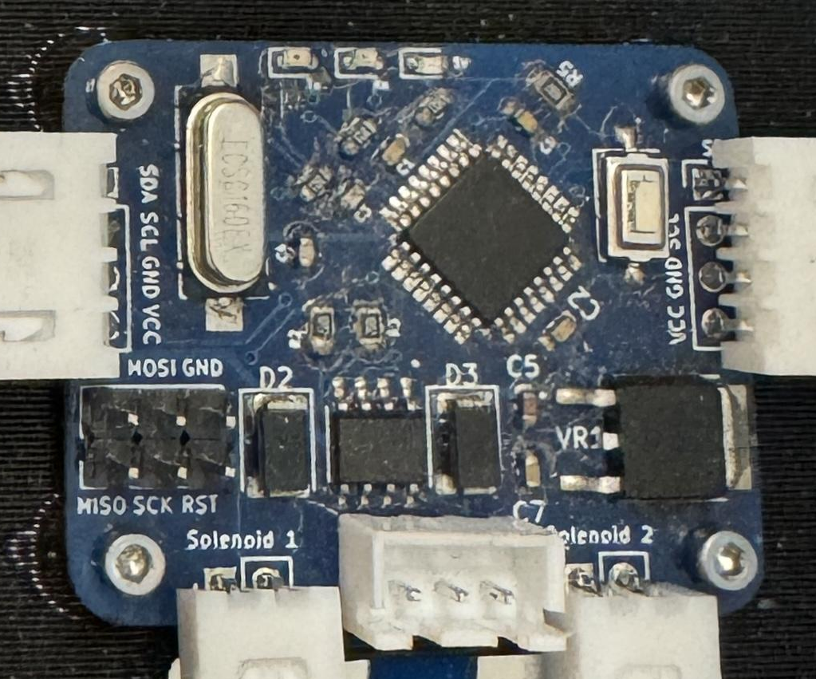
ELECTRICAL DESIGN
Raspberry Pi w/ custom PCB
IMU (BNO055)
12V LiPo Battery
Sixteen solenoids used for stabilization.
Four PCBs controlling roll and pitch.
Two PCBs controlling yaw.
ISAAC Configuration
Solenoid Custom Control PCB

Slide 6
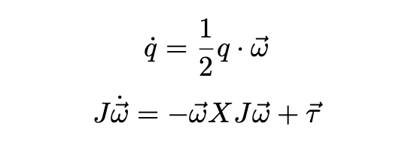
CONTROL THEORY
If-else statements implemented in first version.
Stopped working after one dimension.
Second version tested with sliding mode controller.
Third version with the tested sliding mode controller.
More complicated with more dimensions.
Moved to quaternion control due to complexity.
Equations using quaternion matrix, inertia, angular velocity, and torque to stabilize craft.
Notes:
Full text slide

Slide 7
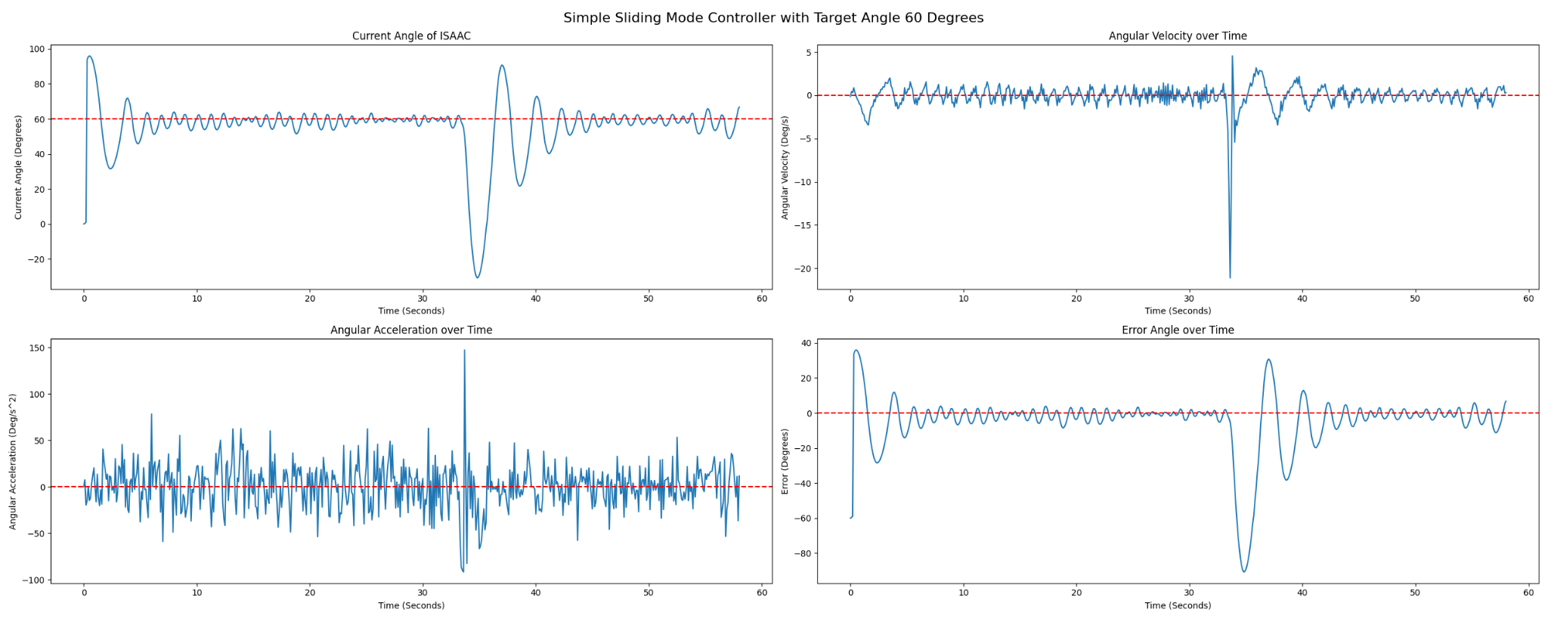
SIMPLE CONTROLLER
Disturbance
Simple sliding mode controller - 60 degree target angle
Example of graphs on easycontrols website showing position (top) and angle error (bottom).
Notes:
Full text slide

Slide 8
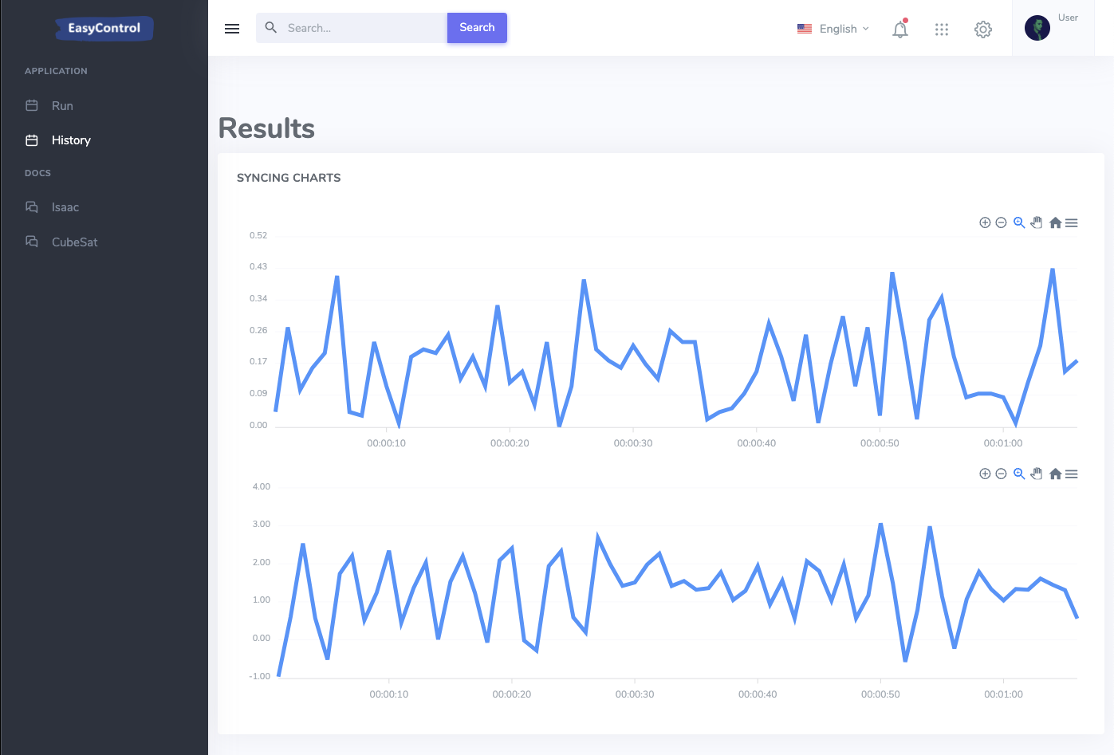
WEBSITE
Easycontrols allows remote uploading/editing of control algorithms.
Users will be able to watch the craft stabilize.
Access to position and velocity graphs.
Will be updated in real-time.
Examples of different types of controllers for beginners.
Website layout example with graph of randomly generated data.
Notes:
Full text slide

Slide 9
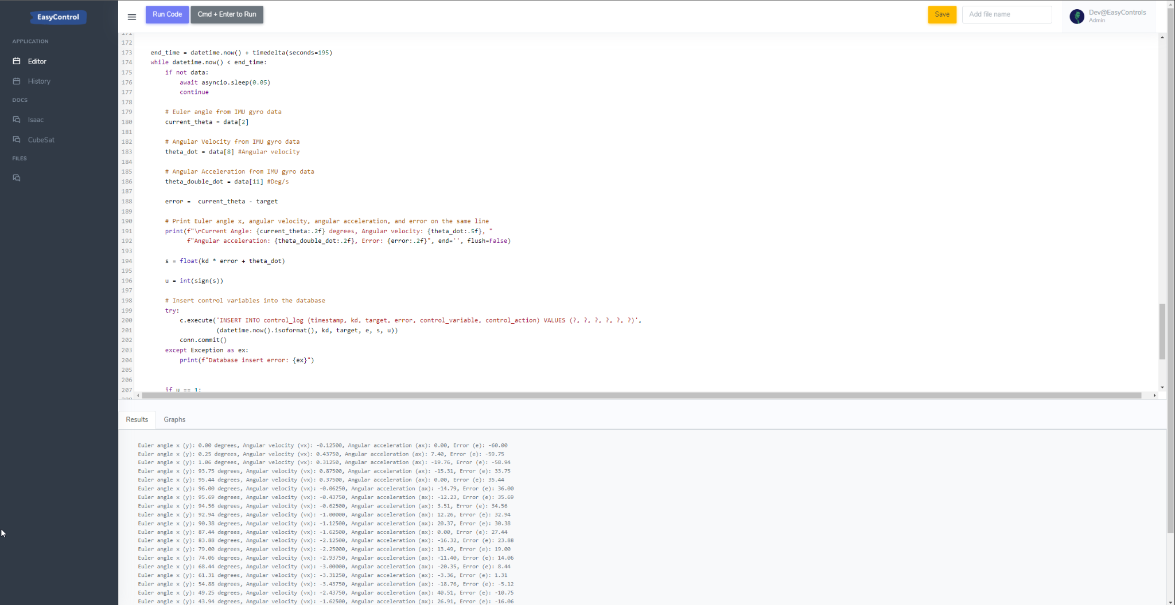
WEBSITE Cont.
Edit code directly on website.
Prints results of code while running.
Notes:
Full text slide

Slide 10
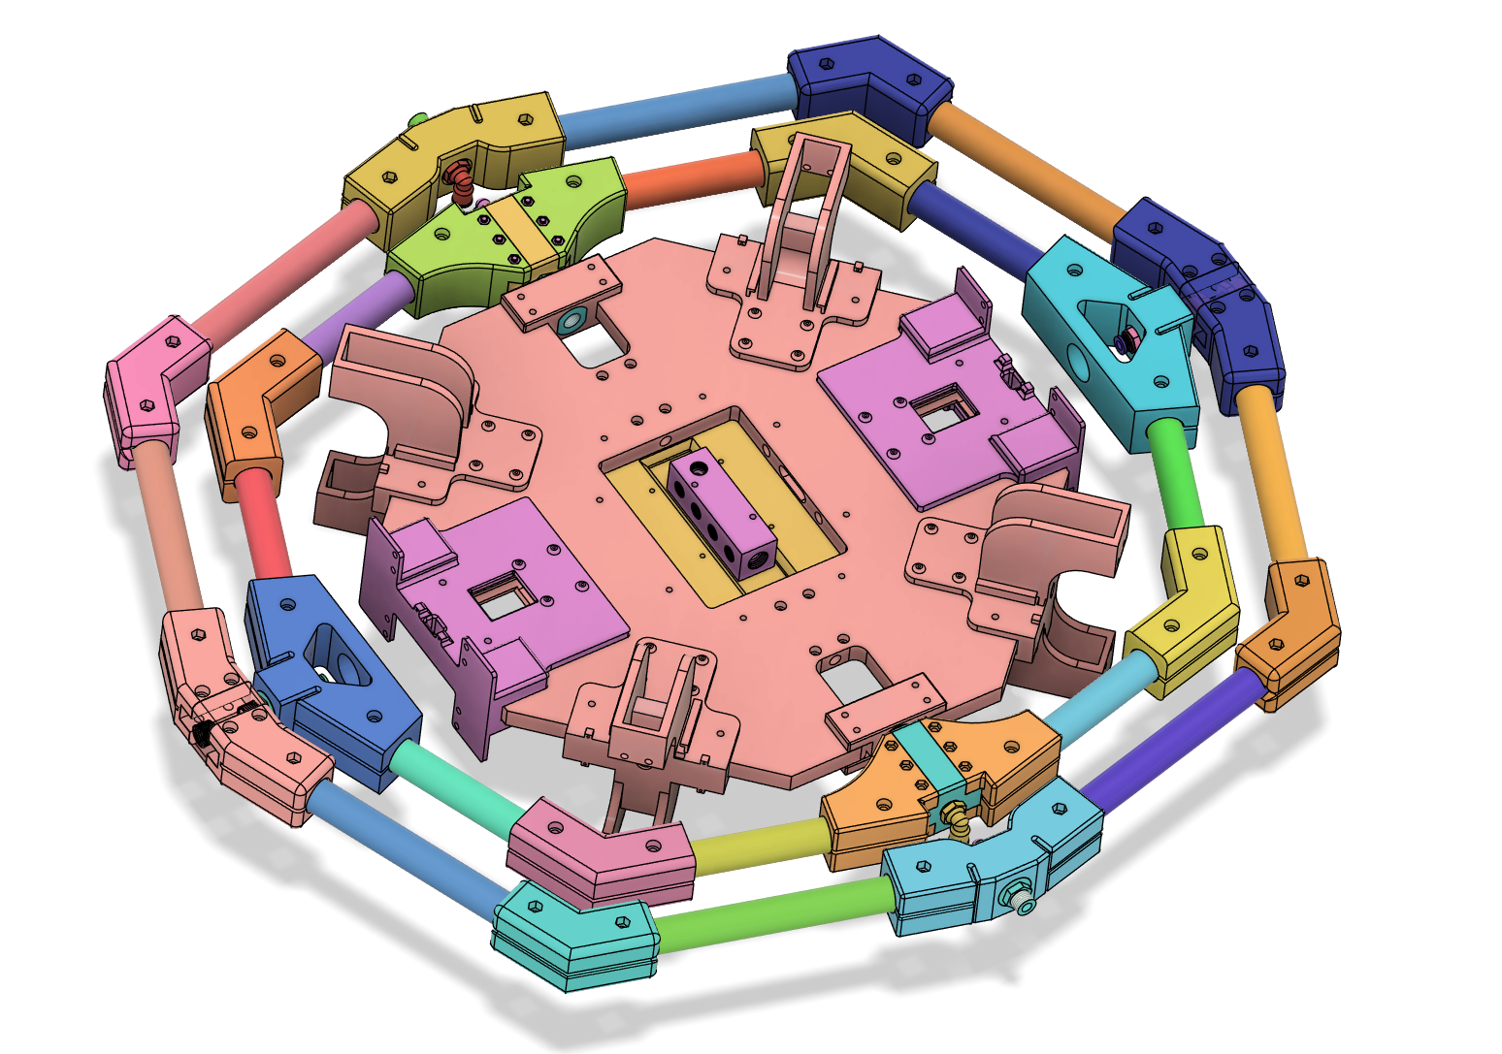
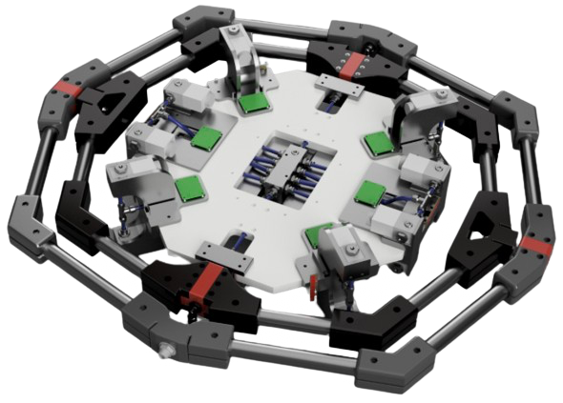
FUTURE WORKS
ISAAC will be tested in two and three dimensions.
Will be using quaternion controller.
Website will implement tutorials and more examples for beginners.
Real-time Unity simulations of ISAAC will display on easycontrols.
Notes:
Full text slide

Slide 11
QUESTIONS
Notes:
Full text slide

